Slide 1
FuelMart & Subway Safety Committee Meeting
Wednesday, October 16, 2019
2:00 PM
Corporate Office Conference Room and GoTo Meeting Web Conference

Slide 2
August 2019 Review:
Safety Topic – School Zone Safety
No open safety concerns or suggestions for improvements

Slide 4
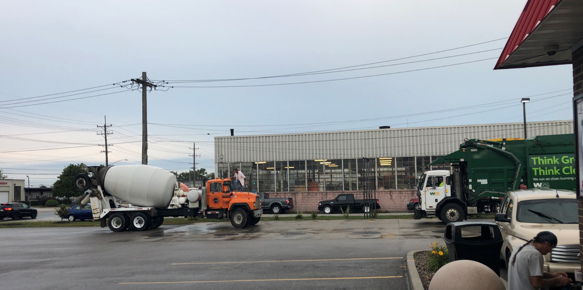
Employee Concerns:
FM 701 on 09/25/19 a fuel delivery driver brought indicated customers park on the fuel drop lids for the underground storage tanks. Determined the transportation dept. can adjust delivery time to not delivery during the busiest store times.

Slide 5
Employee Concerns:
FM 701 on 09/26/19 a fuel delivery driver indicated there is water in the premium drop bucket for the underground storage tanks.
Reminder to continually check for water in the drop bucket especially after rain and other adverse weather conditions with winter approaching (snow & ice).
FM 648 on 10/15/2019 a fuel delivery driver indicated there is no vapor cap on tank one.

Slide 6
Incidents and Injuries From 09/17/2019 to 10/14/2019

Slide 7
Employee Injuries:
Previous Injury - 08/31/2019 – Employee was changing outside garbage. After pulling the bag out of the trash can the employee lost balance and fell. Employee sought medical treatment.

Slide 8
FM 641 Customer to Customer vehicle Incident:
On 09/24/2019 a customer was standing outside of his semi on the driver side when a semi-trailer drove through the pump lane next to him and the trailer tire struck a FM bollard causing the trailer tire to blow. The customer indicated he was struck by pieces of the blown tire. The at fault driver did not stop and left the property. Another customer notified FM employees. FM employees found the semi-trailer across the road at another truck stop. FM employee asked if the customer needed medical treatment (ambulance) which the customer declined.

Slide 9
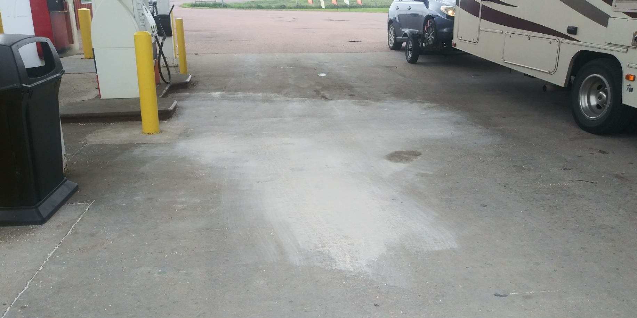
FM 645 Gasoline Spill:
On 09/30/2019 a customer was fueling his truck and looked away and his tank started overflowing. The customer immediately stopped the pump when he noticed it and then went inside FM and notified a FM employee.

Slide 10
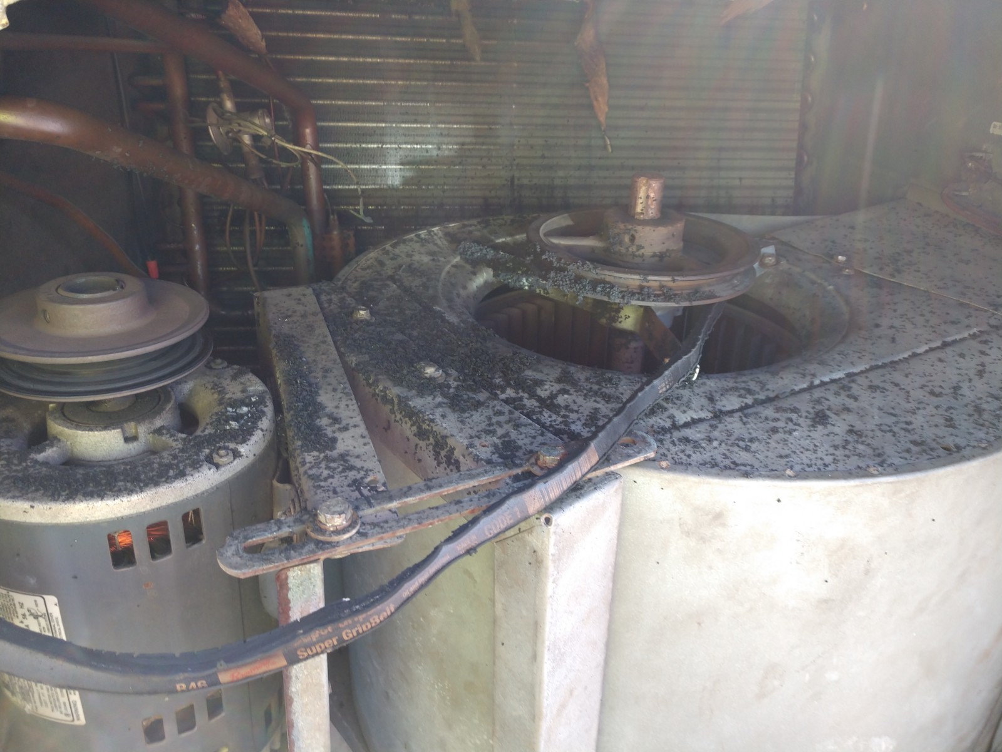
FM 706 AC unit fire:
On 10/01/2019 FM employee noticed / smelled smoke coming from the inside ventilation vent. FM determined it was coming from the ventilation duct work for the AC unit. Local fire dept. was notified and responded. AC unit breaker switch was turned off. Building was evacuated. Fire dept. determined there was an active fire, which they were able to extinguish. Fire was contained to the AC unit.

Slide 11
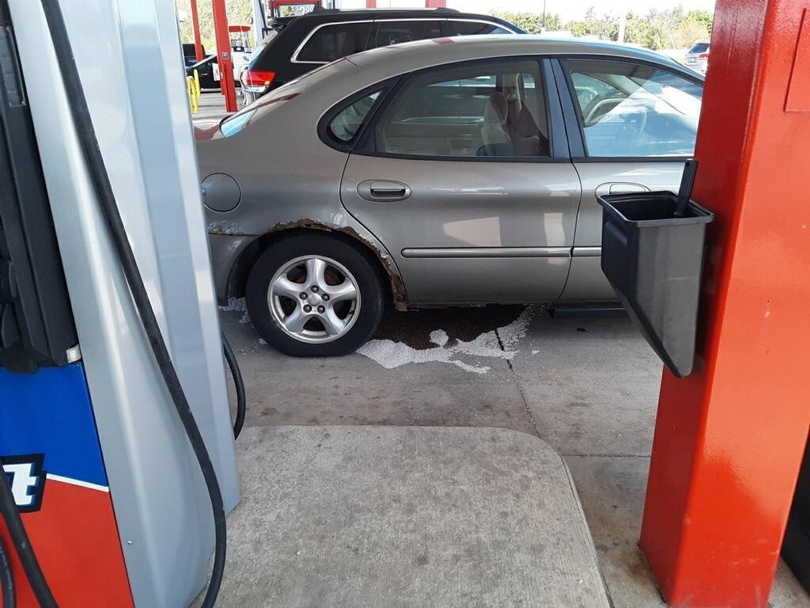
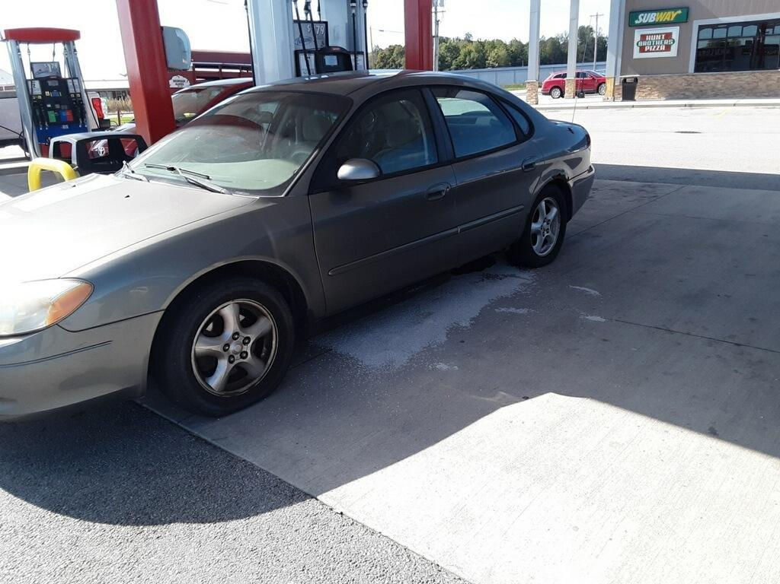
FM 767 Gasoline Spill:
On 10/12/2019 a customer was test driving a car to purchase from a family member. While fueling at pump 4, gas starting pouring out from a hole in the vehicle's gas tank. FM employees were quick to react and put oil dry down to contain the spilled gasoline to the confines of the vehicle's footprint. The owner had the vehicle towed and FM was able to clean up the spill.

Slide 12
FM 782 FM property damage:
On 10/14/2019 a customer pulled away from pump 4 with the nozzle in the vehicle tank filler neck pulling the hose from the pump. The breakaway worked properly. There was no spill.
Safety dept. needs incident report form.

Slide 13
Date Range: Jan. 01, 2019 – October 14, 2019 Company Total Incidents: 137 (Previously 130) FuelMart & Subway Total Incidents: 73 (Previously 68) FuelMart & Subway employee injuries Reported: 13 FuelMart Property Damage and/or Vehicle Incidents: 22 FuelMart Customer Spills: 14 (10 spills at fuel pumps) FuelMart & Subway Customer injuries reported: 18 Other Incidents: 6

Slide 14
Monthly Safety Insp. Forms

Slide 15
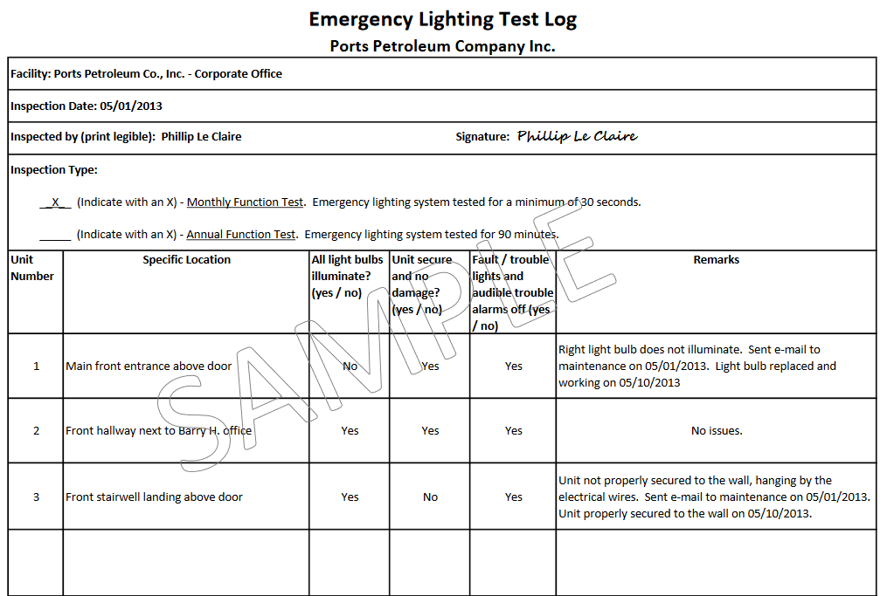
Emergency Lighting Inspections

Slide 16
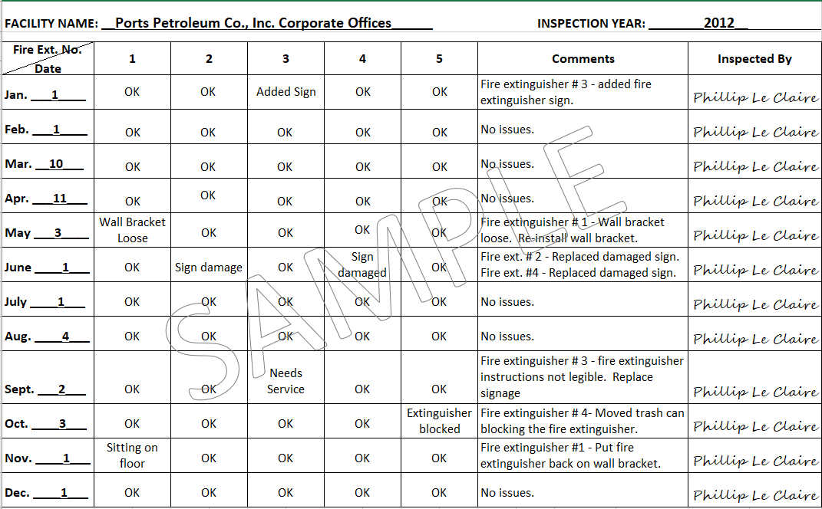
Fire Extinguisher Inspections

Slide 17
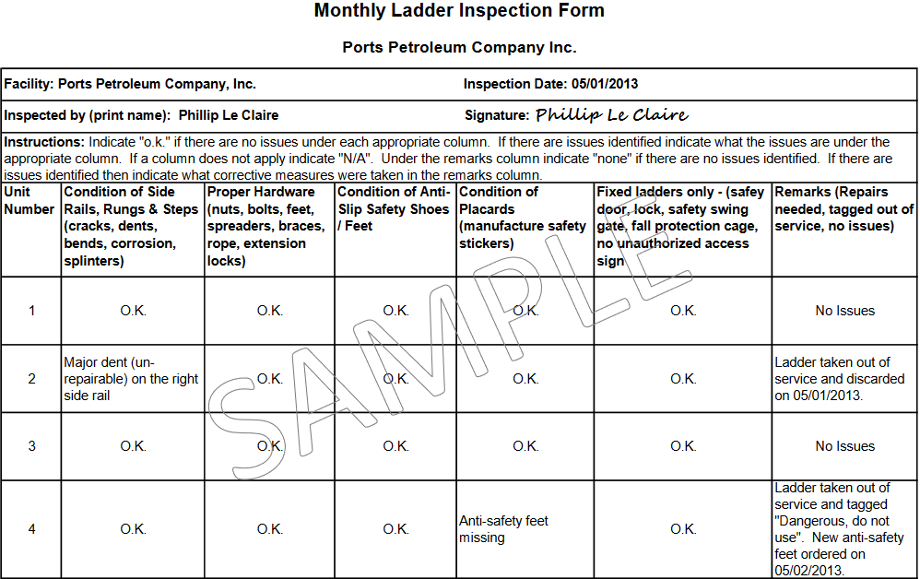
Ladder Inspections

Slide 18
Safety Topic – Fire Prevention (Fire prevention Month)

Slide 19
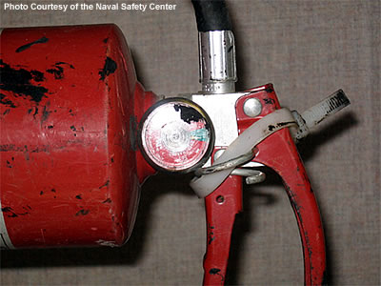
October is Fire Prevention Month
3 of every 5 home fire deaths resulted from fires in homes with a none working smoke alarms.
Less than 50% of homeowners have an escape plan.
Carbon monoxide (CO) is the #1 cause of accidental death.
60% of consumers do not test their smoke and CO alarms monthly.
Only 47% of people report having CO alarms in their home.
Just 43% of homeowners have an escape plan.
Study the picture. Can you identify what's wrong?

Slide 20
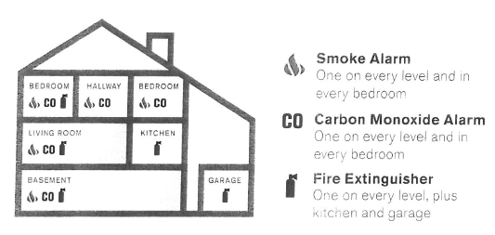
Did you know there are more than one million fires reported in the US every year?

Slide 21
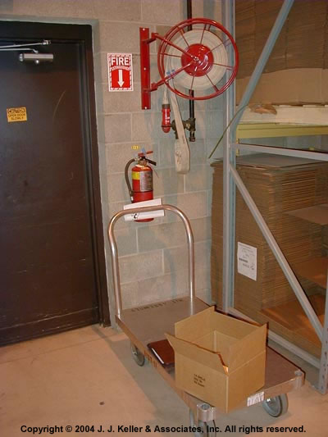
October is Fire Prevention Month
Study the picture below. Can you identify what's wrong?
Be Prepared
Eliminate Hazards
Report Promptly
Evacuate Safely
Everyday General Emergency Safety

Slide 22
What is your safety commitment for work & home???
Whether you’re an employee or a manager, you all have the same goal – you don’t want anyone to get hurt on the job or at home.
There’s something each of us can do to make sure we all go home as whole as when we started the day. One step at a time, we can make our workplaces and homes safer.

Slide 23
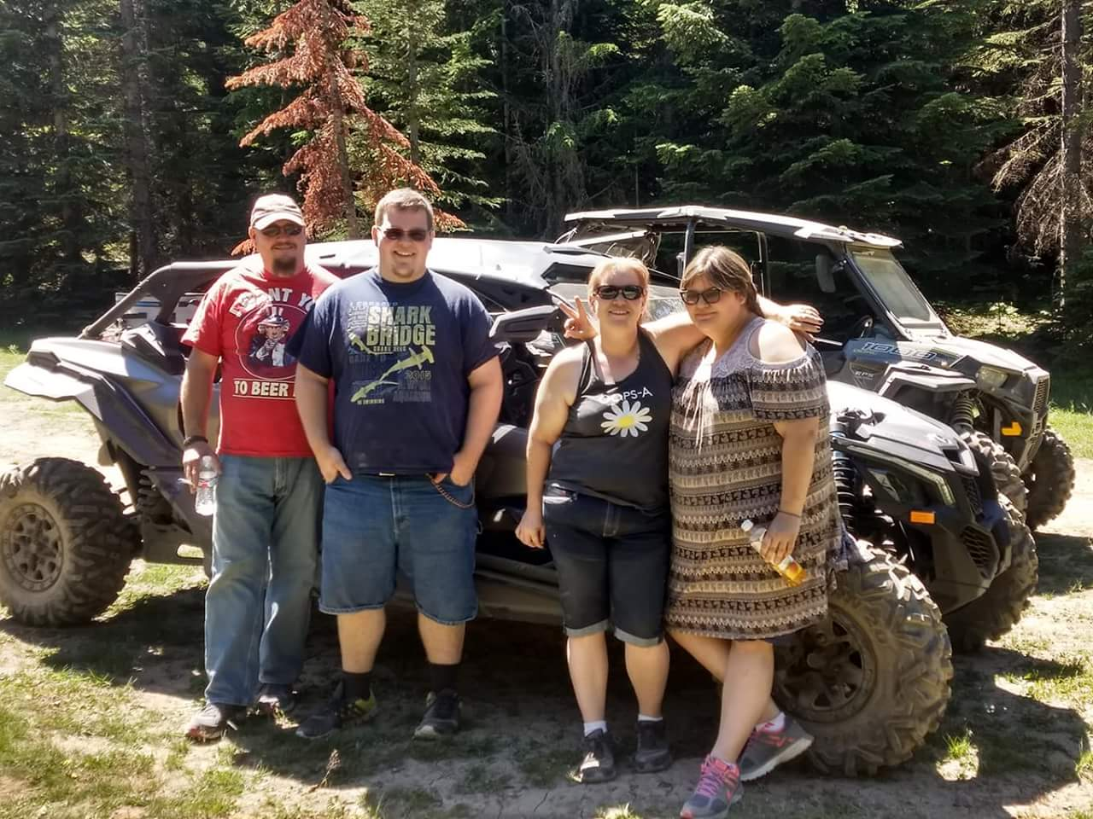
Personal Safety - Safety matters Because:
FAMILY.
Les Meadows, FM 727

Slide 24
Making Safety A Family Affair
Want to Add 500 points to your card

Slide 25
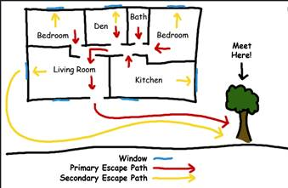
Making Safety A Family Affair
Share a photo that depicts you and your family conducted a home fire drill at your outside meeting location with a sign promoting fire safety at home, fire prevention month, house evacuation map, etc.

Slide 27
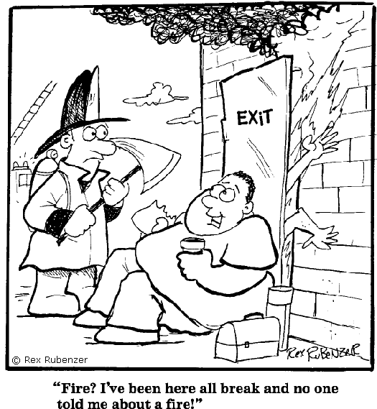
Open Floor Safety Questions / Concerns
Next Safety Committee Meeting is Wednesday, Nov. 20, 2019 at 2:00 PM Eastern

